Slide 1
Computer Vision
Mykhailo Trofimov
22.03.2024
information, 0.92
produced by, 1.00

Slide 2
agenda, 1.00
1. Existing algorithms of object detection
2. Frameworks comparison
3. Example

Slide 3
Object detection methods
Traditional Object Detection :
  Viola-Jones Detector (2001), the pioneering work that started the development of traditional object detection methods
  HOG Detector (2006), a popular feature descriptor for object detection in computer vision and image processing
  Deformable Parts Model (2008) with the first introduction of bounding box regression

Slide 4
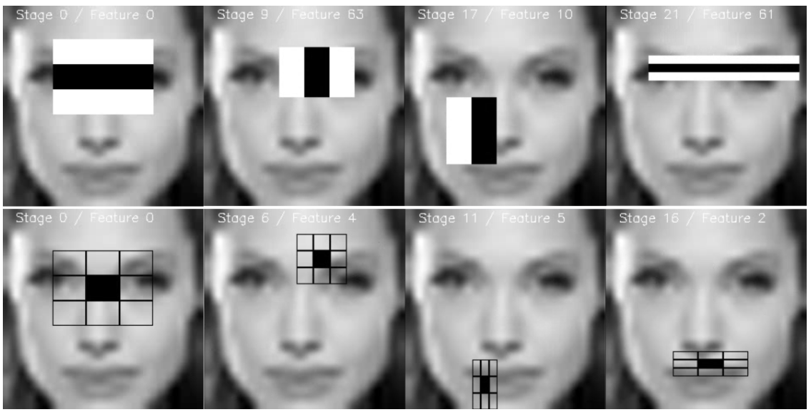
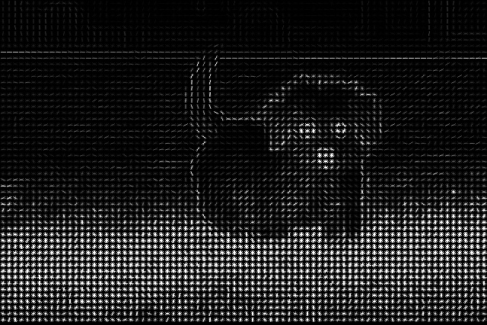
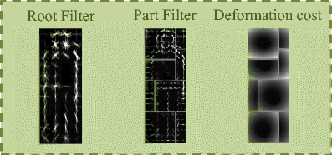
Object detection methods
Viola-Jones Detector
Histogram of Oriented Gradient Detector
Deformable Parts Model

Slide 5
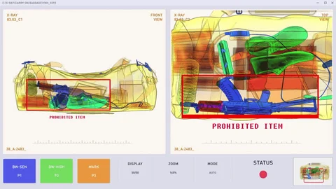
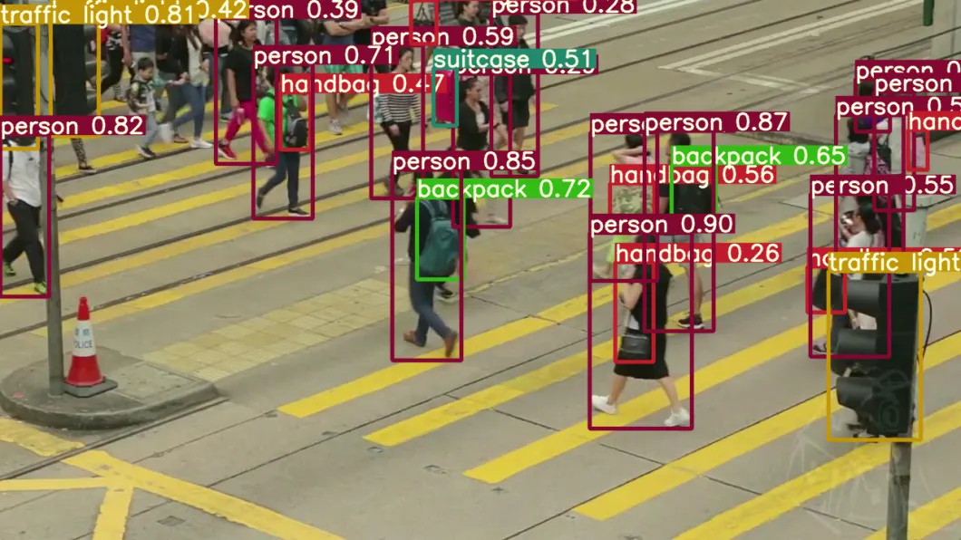
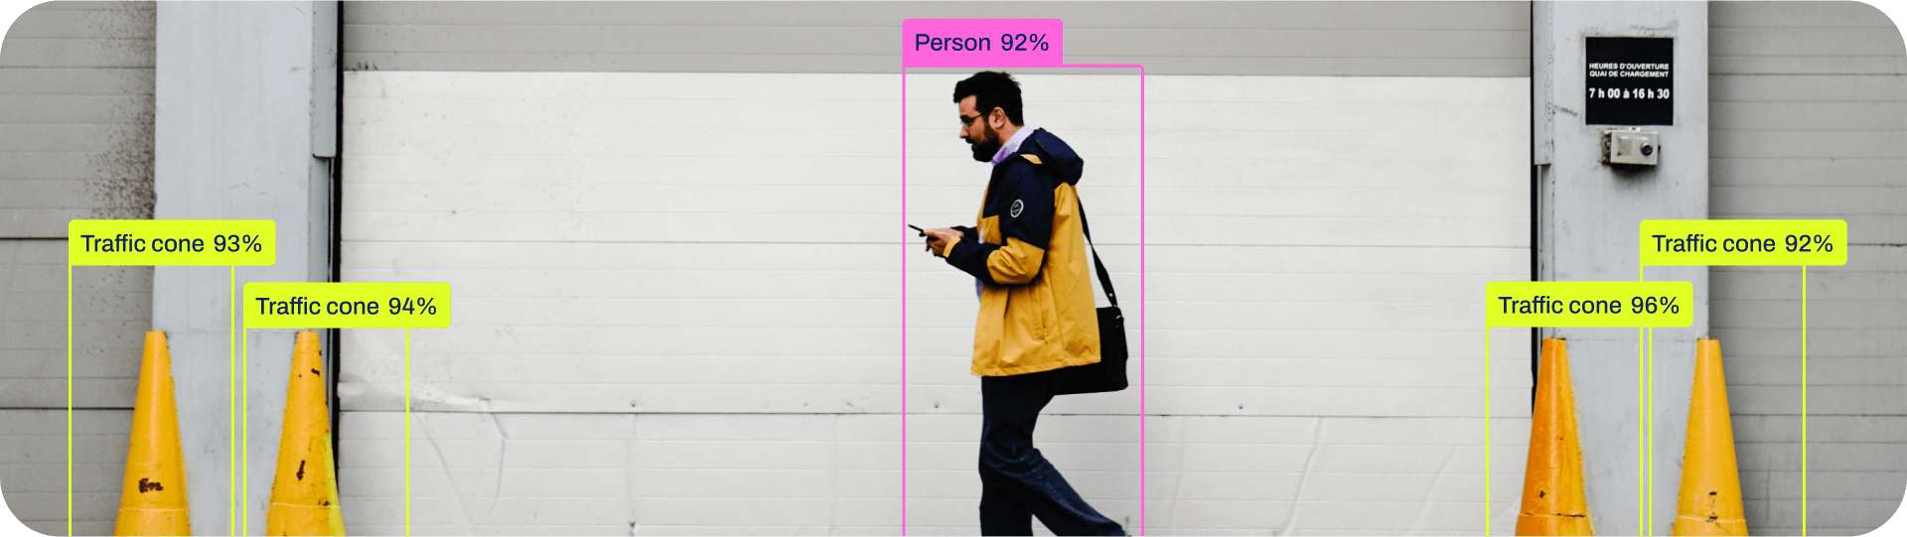
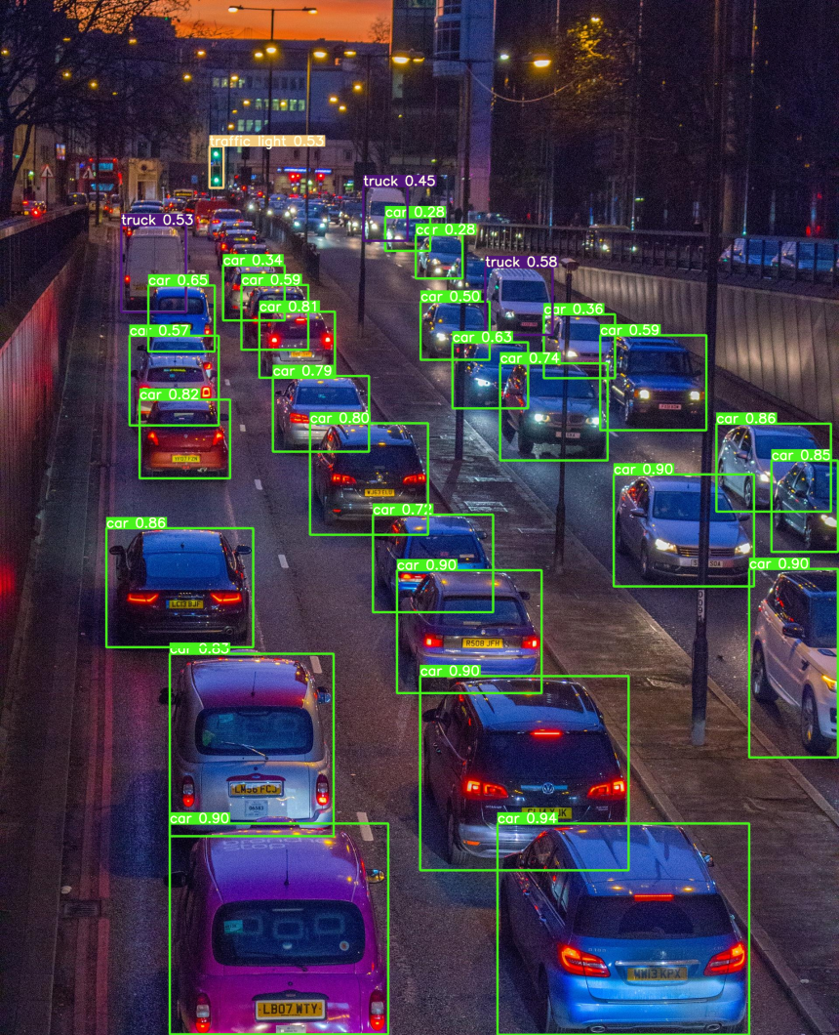
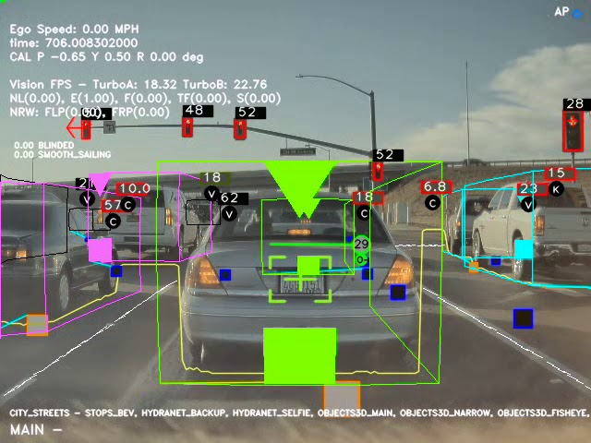
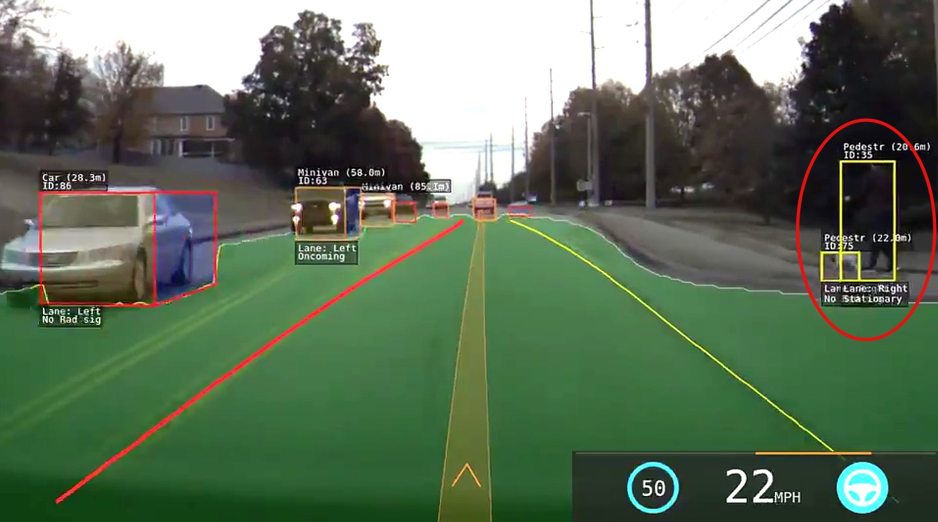
Modern object detection methods use deep learning and neural networks

Slide 6
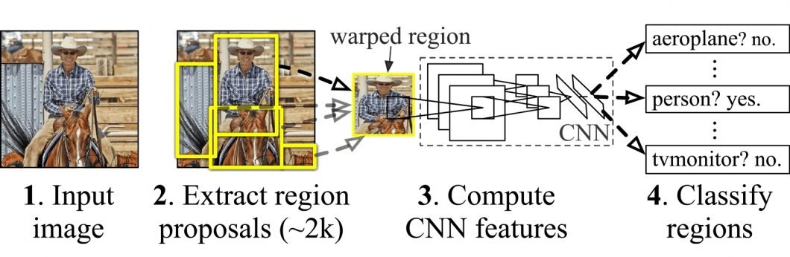
Object detection methods
Deep Learning Detection
  Two-stage algorithms:
    RCNN and SPPNet (2014)
    Fast RCNN and Faster RCNN (2015)
    Mask R-CNN (2017)
    Pyramid Networks/FPN (2017)
    G-RCNN (2021)

Slide 7
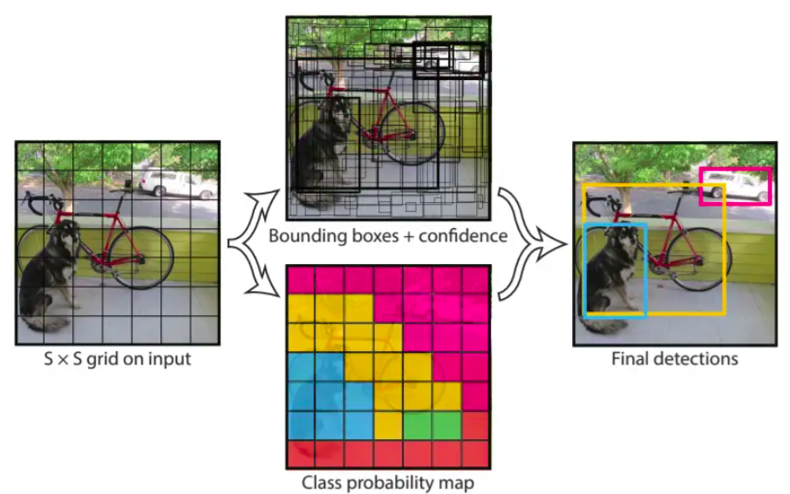
Object detection methods
Deep Learning Detection
  One-stage algorithms:
    You Only Look Once (2016)
    Single-Shot Detector
    RetinaNet (2017)
    YOLOv3 (2018)
    YOLOv4 (2020)
    YOLOR (2021)
    YOLOv7 (2022)
    YOLOv8 (2023)
    YOLOv9 (2024)

Slide 8
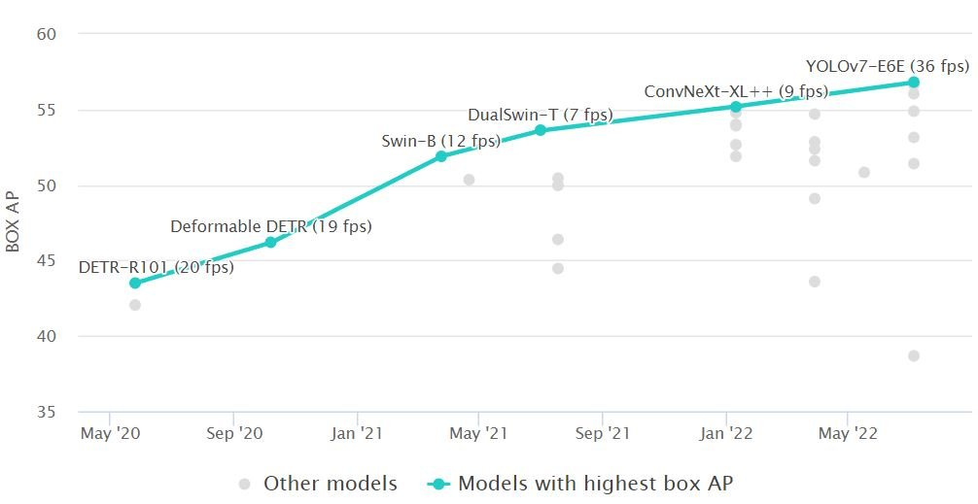
Accuracy comparison by Average Precision (AP)

Slide 9
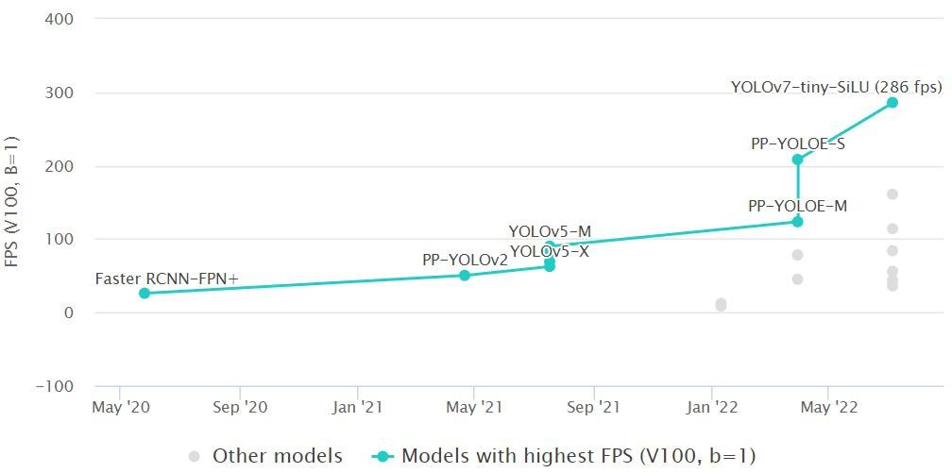
Inference time (ms/Frame, lower is better) or Frames per Second (FPS, higher is better)

Slide 10
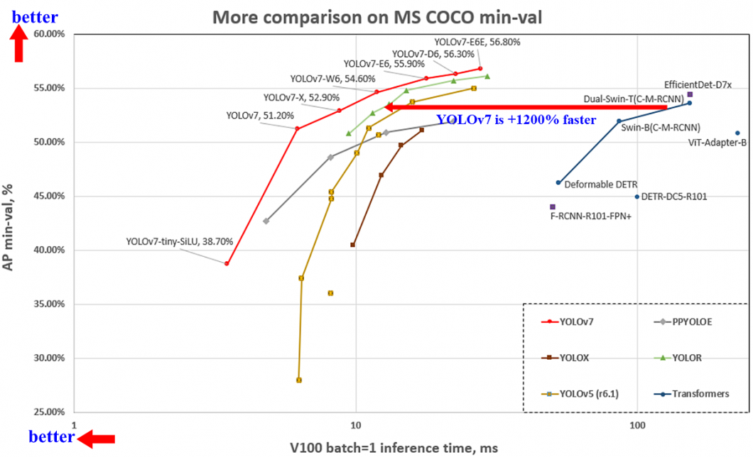
Performance comparison

Slide 11
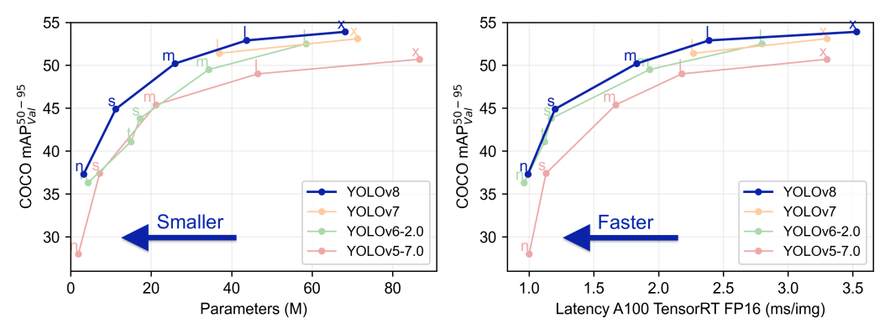
comparison YOLOv7 vs YOLOv8

Slide 12
Usage now?
Trigo - Shoppers in stores wired with Trigo don’t have to wait in checkout lines. Instead, they can directly scan the products using their phone to pay and walk out when they are done.
NAUTO - Over 400 brands use NAUTO’s AI-powered fleet safety platform, and collectively, the system has processed over a billion miles of driver footage.
Regna - They use an AI to extract precise measurements from full-body photos and use it to make their custom-printed and expertly crafted apparel.
Zebra Medical Imaging - enables radiologists to make faster and more accurate diagnoses using the power of AI.
Shield AI -makes use of AI techniques to power a range of military use cases. Primarily, they use powerful AI software and Edge-level AI systems to power unmanned vehicles and assist pilots in areas with no GPS or other communication.

Slide 13
What’s Next?
Segment Anything Model (SAM) that can identify objects without training

